Slide 1
Terabase-scale metagenomics and beyond at the DOE-JGI
Robert Riley
22 Jul 2021

Slide 2
Robert Riley, Bioinformatics Data Scientist
1997 - B.S. Biochemistry and Molecular Biology (after starting as music major)
2001-2007 - Ph.D. Human Genetics/Bioinformatics; Eisenberg lab
2007-2009 - Bioinformatics Scientist; Mycobacterium tuberculosis
2009-2017 - Data Scientist; Fungal Program
2018 - Bioinformatics Scientist; synthetic biology
2019-present - Staff Data Scientist; genome assembly

Slide 3
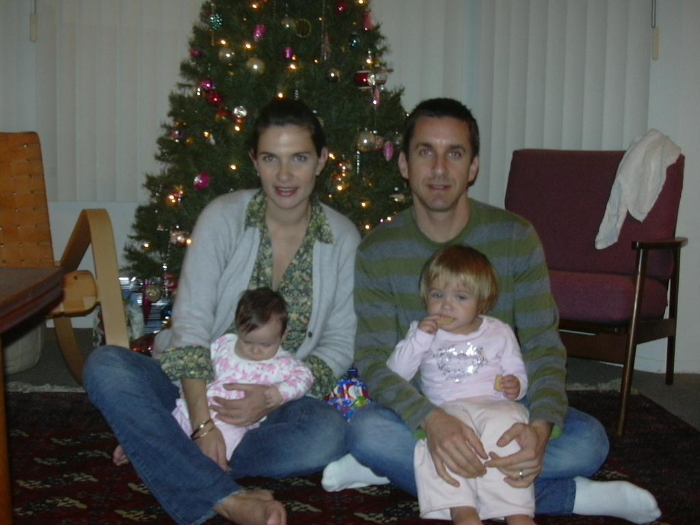
Evolution of the Riley family
UCLA 2004
Walnut Creek 2021

Slide 4
Outline
Overview of the JGI
Terabase scale metagenome assembly
Broader directions at the JGI

Slide 5
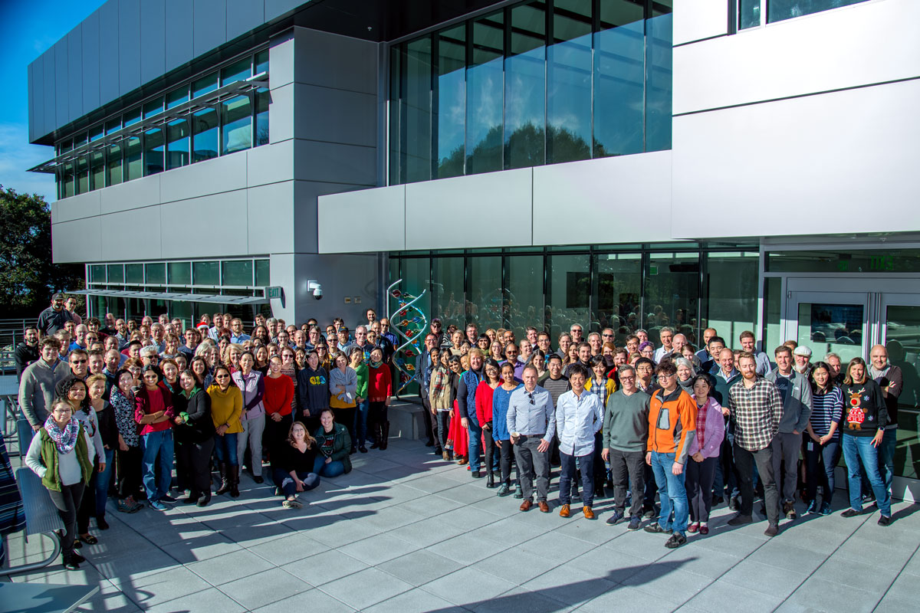
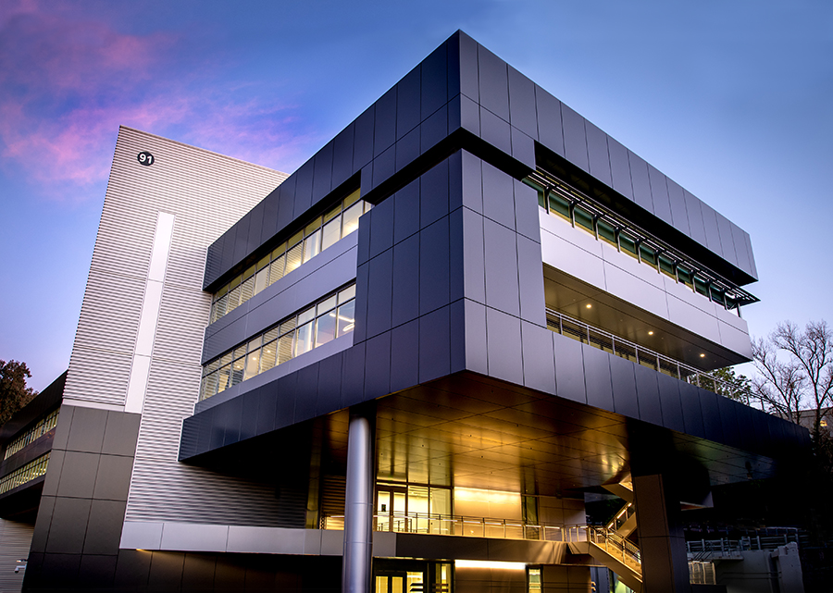
DOE Joint Genome Institute
Who we are…
A DOE Office of Science User Facility
~280 staff
Walnut Creek, CA facility opened in 1999
New home: Integrated Genomics Building, Berkeley Lab campus, 2019-present
Integrative Genomics Building (IGB)
JGI enables its research partners to solve the world’s most critical energy and environmental challenges
Move planned for 2019

Slide 6
Evolution of JGI science

Slide 7
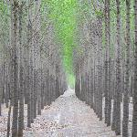
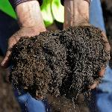
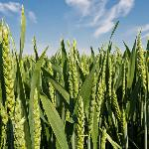
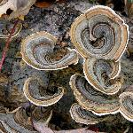
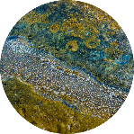
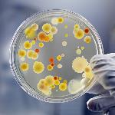
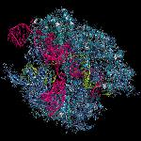
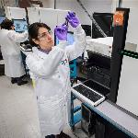
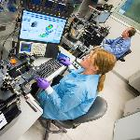
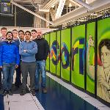
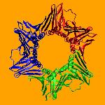
Integrative omics at the JGI
Bioenergy
Carbon Cycling
Biogeochemistry
Mission Areas
Plants
Fungi
Metagenomes
Microbes
Engineering Biology
Programs
Infrastructure
DNA Sequencing
Illumina platforms: NovaSeq, MiSeq, Next Seq
PacBio platforms: Sequel, Sequel II
Oxford Nanopore platforms: MinION, PromethION
Advanced Genomic Technologies
Single-cell Seq
Metabolomics
Methylation
Epigenomics
Transcriptomics
Computational Analysis
Assembly/ Annotation/Analysis
High-Performance Computing
Big Data Integration & Analysis Systems
DNA Synthesis
Design & Pathway Assembly
Host Engineering

Slide 8
Terabase-scale metagenome assembly
The unique problems of metagenome assembly
Metagenome coassembly vs. multiassembly
MetaHipMer, an extreme scale metagenome assembler
Benchmarking MHM vs. state-of-art assembly software
JGI user science supported by MHM
Largest metagenome co-assembly: 8 TB of reads
Future coassembly milestones: 16 TB, 30 TB, etc.

Slide 9
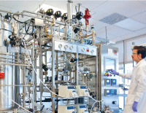
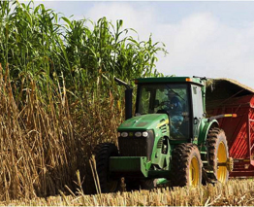
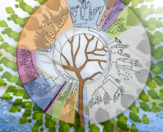
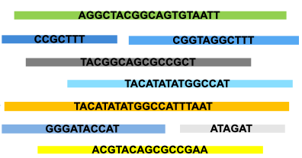
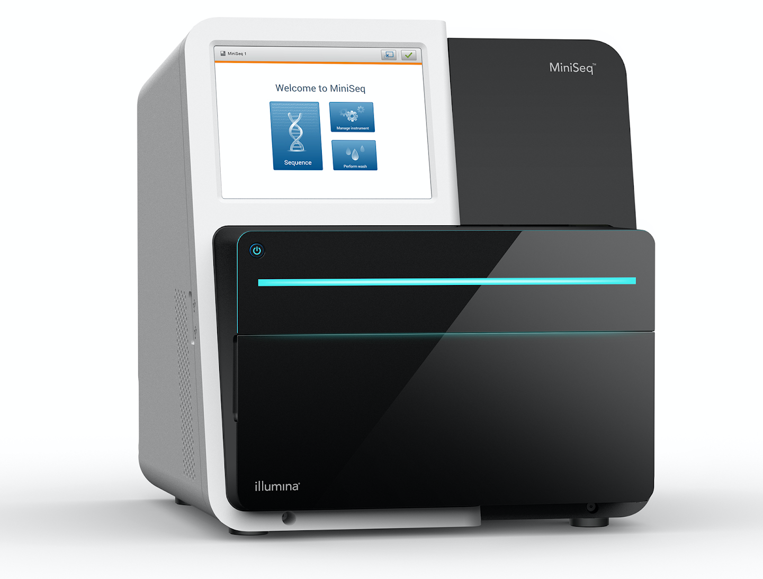
Metagenome sequencing and assembly overview
Environment
Bio-Manufacturing
Bio-Energy
Plant, Animal and Human Health
NeLLi
Infer genome sequences
Assemble
Underlying genomes (up to 10⁷ bases long each; MB-GB total sequence)
Short reads (100-300 bases long; GB-TB of data produced)
Sequencer

Slide 10
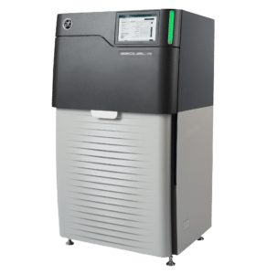
The unique problems of metagenome assembly
Long reads
Repeat content
Varying abundance/
community complexity
Microbial community
Sequence
Assemble
Incomplete/fragmented assemblies
Strain heterogeneity
ACGTACGTACGTCGA
ACCGTACTCAGTTCAT
AGTAGTAGTAGTAGTAGCCCGGGA
ATACGCGAGCTCT
Lack of reference genome
Notes:
in some ways strain heterogeneity is a compound issue of repeats (or what looks like repeats to the assembler) & abundance so you might want to say that instead of saying it is unsolved
It would be good to say something additionally about community complexity since this is a related but separate problem from abundance

Slide 11
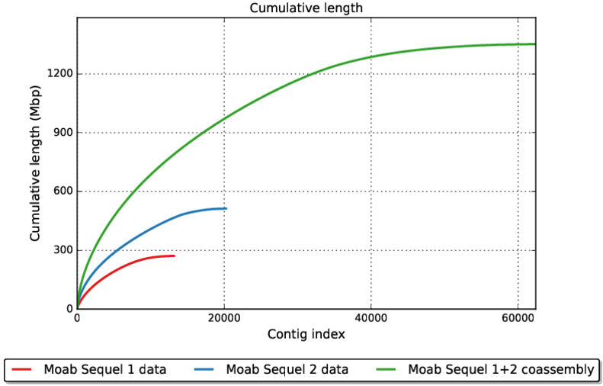
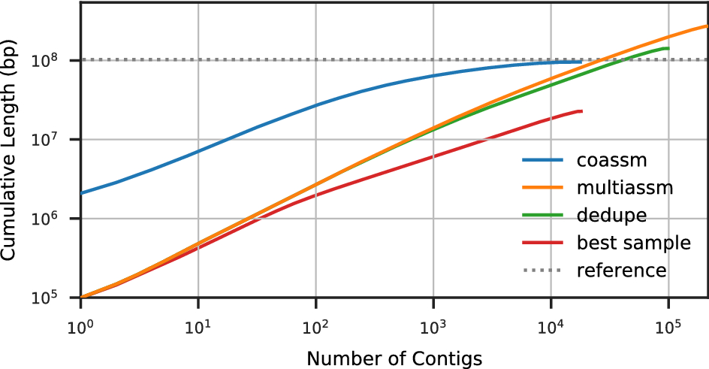
Metagenome co-assembly vs. multi-assembly
Multiassembly: assembling many samples separately
Coassembly: assembling many samples together
Van Goethem et al. (bioRxiv 2021.01.23.426502; doi: https://doi.org/10.1101/2021.01.23.426502)
Hofmeyr, S et al. Sci Rep 10, 10689 (2020)
Number of contigs
Dedupe: remove duplicates from multiassemblies
Coassembly of all samples together = more & longer sequence than multiassemblies
Notes:
At some point it might be good to get ahead of the question of "why not just sequence individual samples deeper?" You see the same type of curve when sequencing an individual sample deeper. We are budget limited It is b/c given larger sequencing allocations PIs generally prefer to send a larger number of samples from different time points, depths, etc instead of sequencing fewer samples more deeply. Sequencing a larger number of samples and then doing a large co-assembly of samples together optimizes for the most information.

Slide 12
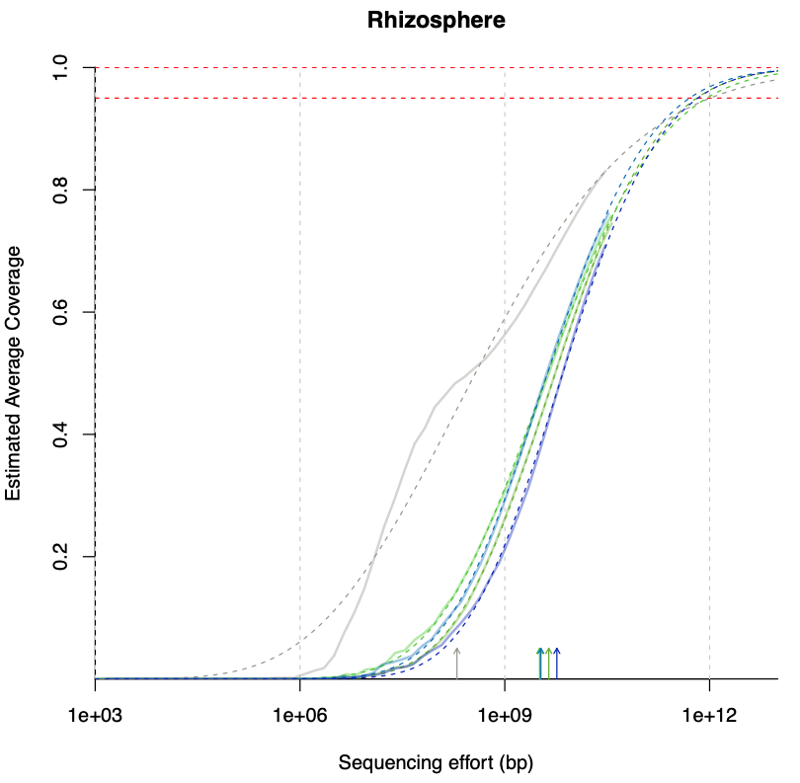
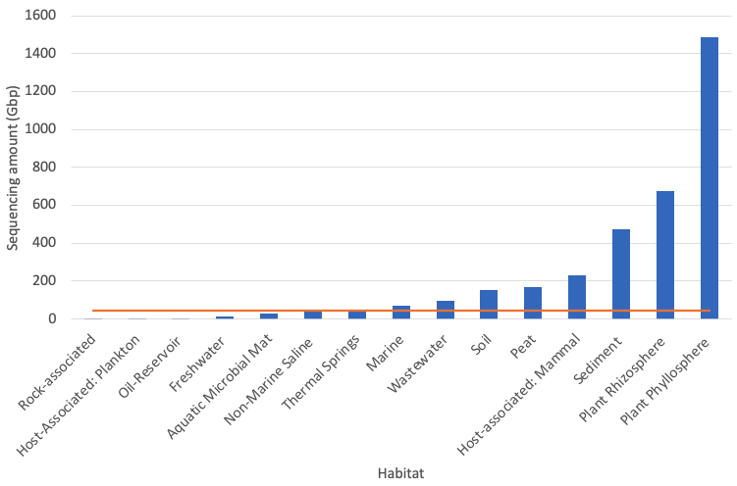
We need coassembly because complex metagenome environments are being undersequenced
Projected required sequencing for 95% coverage of sample diversity
Amount of sequencing you have done
Coverage analysis done by Kelly Cobaugh using Nonpareil 3
Nonpareil 3: Fast Estimation of Metagenomic Coverage and Sequence Diversity. Rodriguez-R, et al. mSystems Apr 2018, 3 (3) e00039-18; DOI: 10.1128/mSystems.00039-18

Slide 13
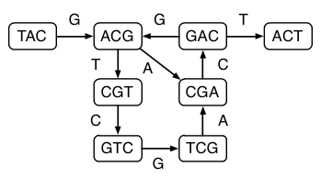
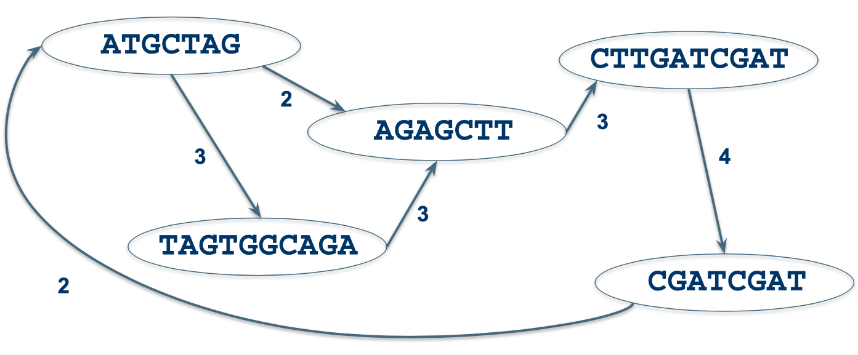
Graph data structures in genome assembly
Overlap layout consensus graph (long reads)
de Bruijn graph (short reads)
Genome:
ATGCTAGTGGCAGAGCTTGATCGATCGAT
Reads:
TACGACT
GTCGACT
GTCGACG
etc.
Represent unique kmers in reads
Reads:
Kmer: a substring of defined length; k = 3 in this case

Slide 14
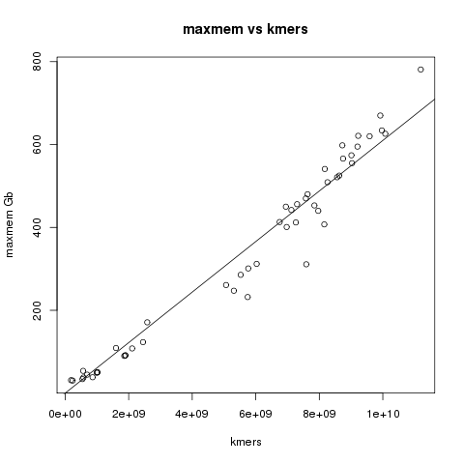
Why not always coassemble metagenome data?
High-memory node (1,500 GB RAM) not enough to coassemble many datasets
Most state of the art metagenome assemblers can only run on a single compute node
de Bruijn graph grows with number of kmers in data (complexity)
k = 3
To assemble terabytes of metagenome data, we need an assembler that will run on many compute nodes, potentially using petabytes of memory
Typical compute node
Terabyte-scale metagenome datasets have 10s or 100s of billion kmers (substring of length k)

Slide 15
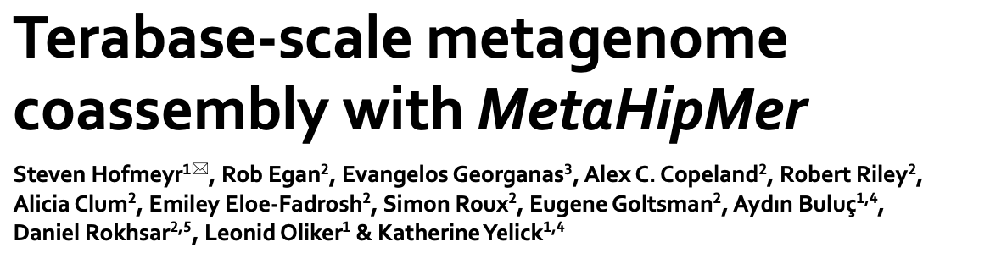
MetaHipMer: an extreme scale metagenome assembler
Evolution of MetaHipMer
MetaHipMer 2
Released Sep 2020
New scaffolding algorithms
avoid scaling bottlenecks
improved assembly quality matches other leading assemblers
Runs 2x to 10x faster than MHM1 and uses 2x less memory
ExaBiome Project: http://exabiome.org
Notes:
We describe a new algorithm, meraculous, for whole genome assembly of deep paired-end short reads, and apply it to the assembly of a dataset of paired 75-bp Illumina reads derived from the 15.4 megabase genome of the haploid yeast Pichia stipitis. More than 95% of the genome is recovered, with no errors; half the assembled sequence is in contigs longer than 101 kilobases and in scaffolds longer than 269 kilobases. Incorporating fosmid ends recovers entire chromosomes. Meraculous relies on an efficient and conservative traversal of the subgraph of the k-mer (deBruijn) graph of oligonucleotides with unique high quality extensions in the dataset, avoiding an explicit error correction step as used in other short-read assemblers. A novel memory-efficient hashing scheme is introduced. The resulting contigs are ordered and oriented using paired reads separated by ,280 bp or ,3.2 kbp, and many gaps between contigs can be closed using paired-end placements. Practical issues with the dataset are described, and prospects for assembling larger genomes are discussed.

Slide 16
MetaHipMer: an extreme scale metagenome assembler
reads
1) K-mer Analysis K-mer histogram
1
Iterate for k+s
k-mers
2) Contig Generation Walk k-mer graph
2
Extract k+s-mers
contigs
3) Alignment Align reads to contigs
3
read-contig
alignments
4) Local Assembly
Extend ends of contigs
extended
contigs
4
contig-contig scaffolds
5
5) Scaffolding
Walk contig graph (iterate)
Actual pipeline is more complex, simplified for purpose of presentation
ExaBiome Project: http://exabiome.org

Slide 17
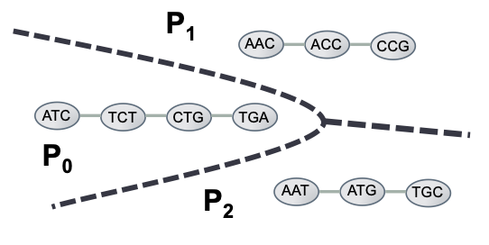
Distributed De Bruijn graph
Memory use scales with number of kmers for De Bruijn graph assemblers
MetaHipMer attempts to assign each contig’s kmers to a specific processor
E. Georganas et al., "HipMer: an extreme-scale de novo genome assembler," SC '15: Proceedings of the International Conference for High Performance Computing, Networking, Storage and Analysis, Austin, TX, USA, 2015, pp. 1-11
Notes:
A de Bruin graph of k-mers where k = 3. In this graph we can identify three contigs or equivalently three connected components. The dashed lines indicate an optimal partitioning of the graph with p = 3. Each processor will work only with local k-mers during the traversal
If given an oracle partitioning function that could accu- rately predict how the k-mers are placed into contigs, the k-mers could be partitioned in such a way that k-mers ul- timately belonging to the same contig would be mapped to the same processor. Thus, during the traversal a processor would incur no communication, since none of the k-mer ac- cesses (lookups in the distributed hash table) will require communication — all the vertices of the de Bruijn graph that build up a particular contig are local to a single proces- sor (local buckets in the distributed hash table).
Rob: We use minimizers (i.e. a small sub kmer) to clump a bunch of related larger-kmers on the same processor... The hash of the minimizer is the processor and the hash of each of the full kmers is used to store in a hashmap / lookup table for the kmers that the processor maintains. Then during the contig construction -- essentially a billion separate debruijn graph traversals -- each contig is like a humming bird on a flower patch.... buzzing for a while among adjacent flowers and then zipping off to a new cluster of flowers... only here each cluster is the kmers sharing the same minimizer. The key here is that even if the next extension kmer in the graph is not present in the data (i.e. 3 of the 4 possible kmer extension bases should fail during a successful graph walk) the failed lookups should *also* hit the same processor most of the time so it is nearly instant.
And then in this analogy, the humming bird is a remote procedure call -- effectively one processor telling another to do a bit of work on its behalf. So essentially we can have this packet of data on the network representing a contig-in-construction growing and hopping from one processor to another until it naturally ends and returns to its origin processor to store the resulting contig in memory.

Slide 18
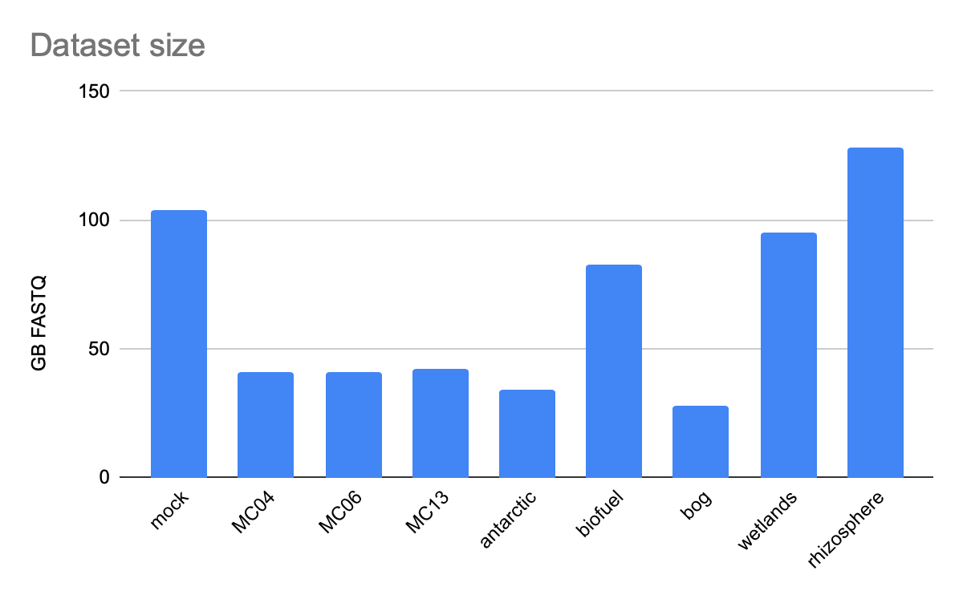
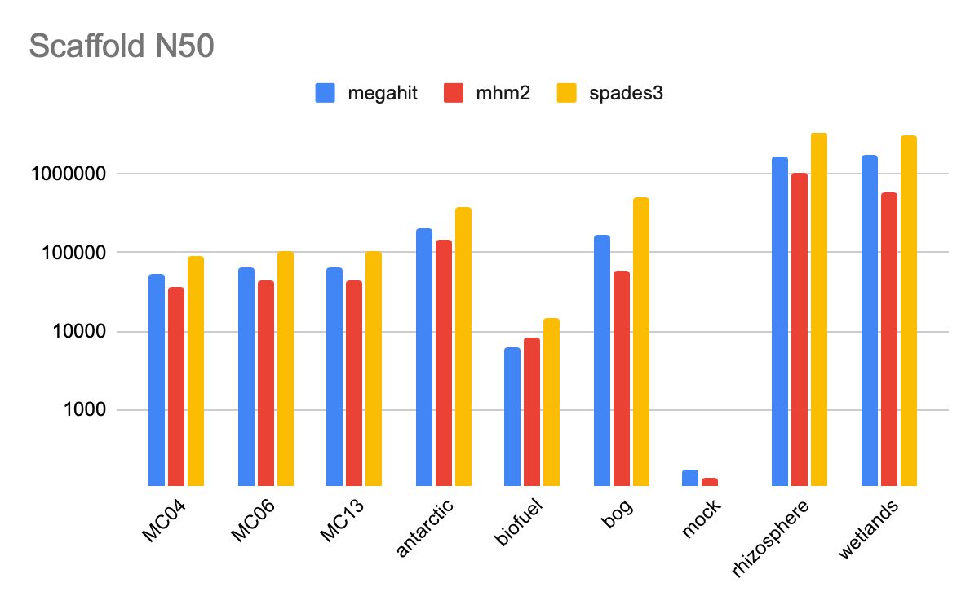
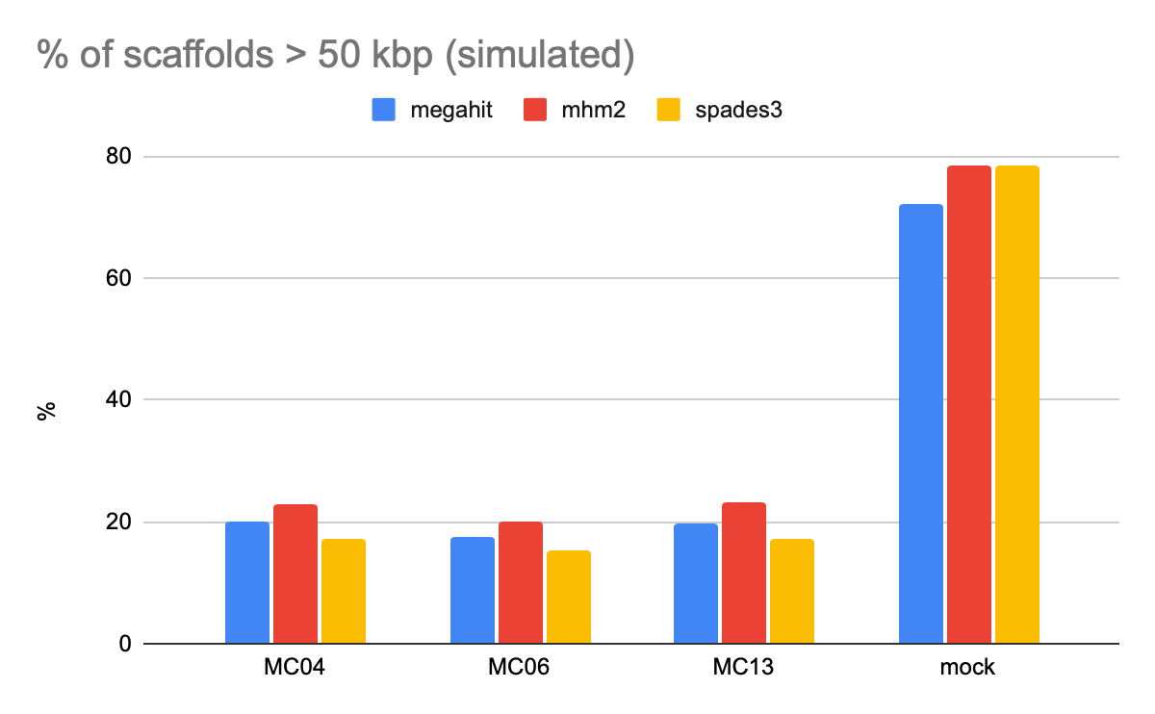
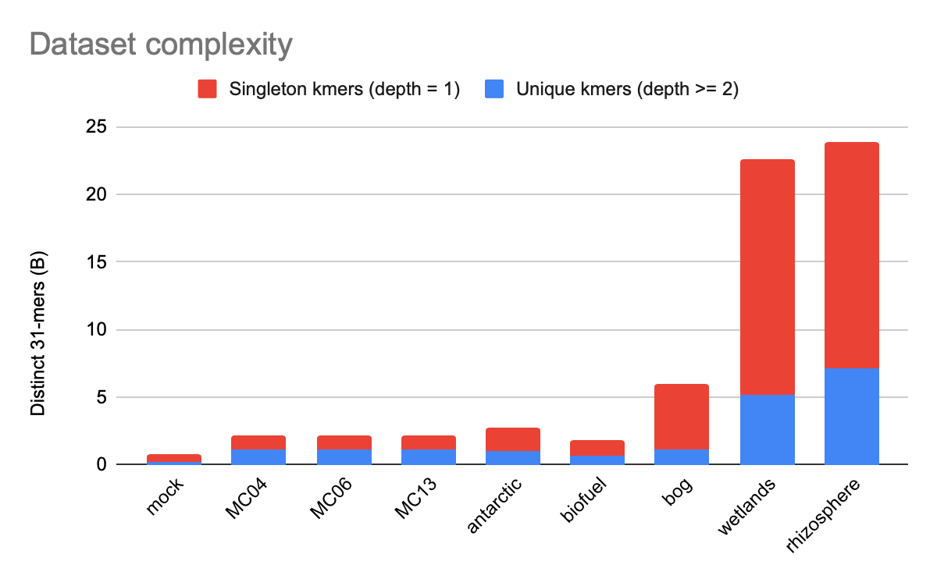
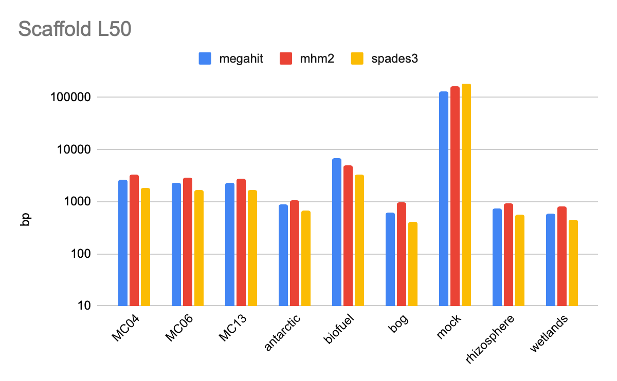
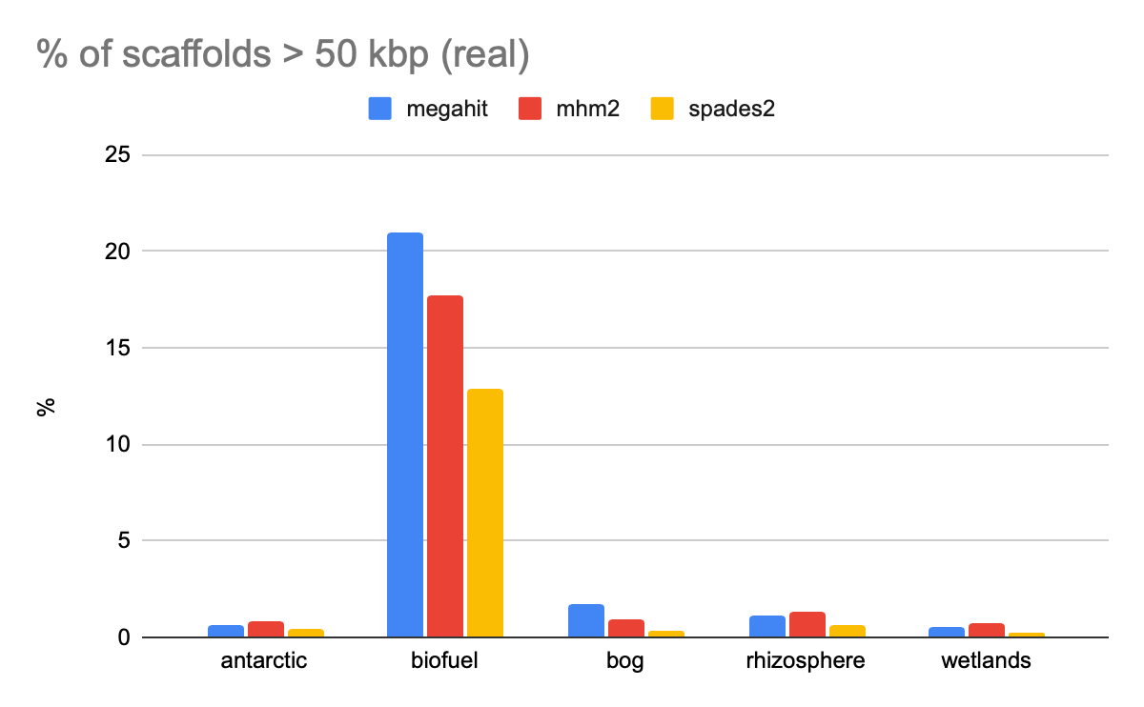
MHM2 assembly quality is comparable to state-of-the art assemblers
Benchmark datasets
Results
Real
Simulated
Dinghua L. et al. MEGAHIT: an ultra-fast single-node solution for large and complex metagenomics assembly via succinct de Bruijn graph, Bioinformatics 2015
Nurk S. et al. metaSPAdes: a new versatile metagenomic assembler. Genome Res. 2017

Slide 19
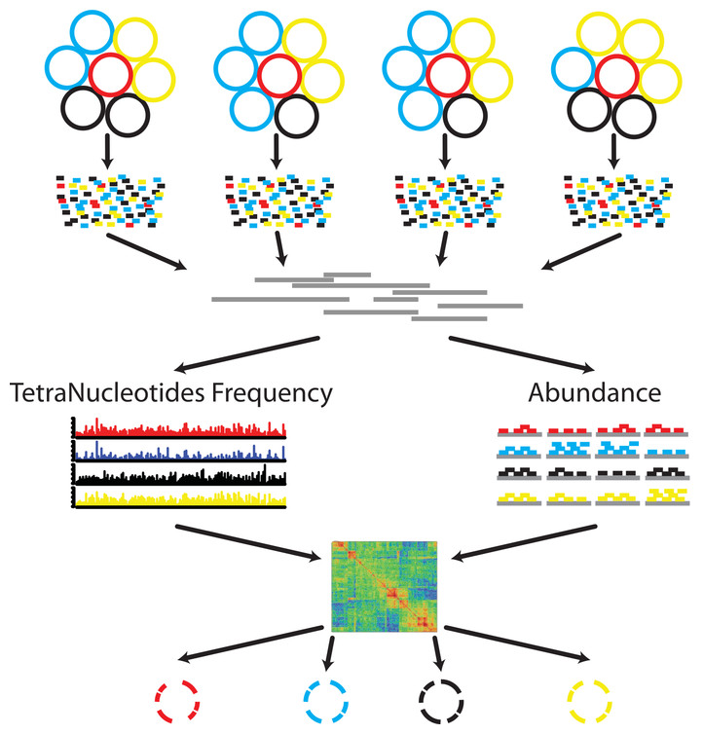
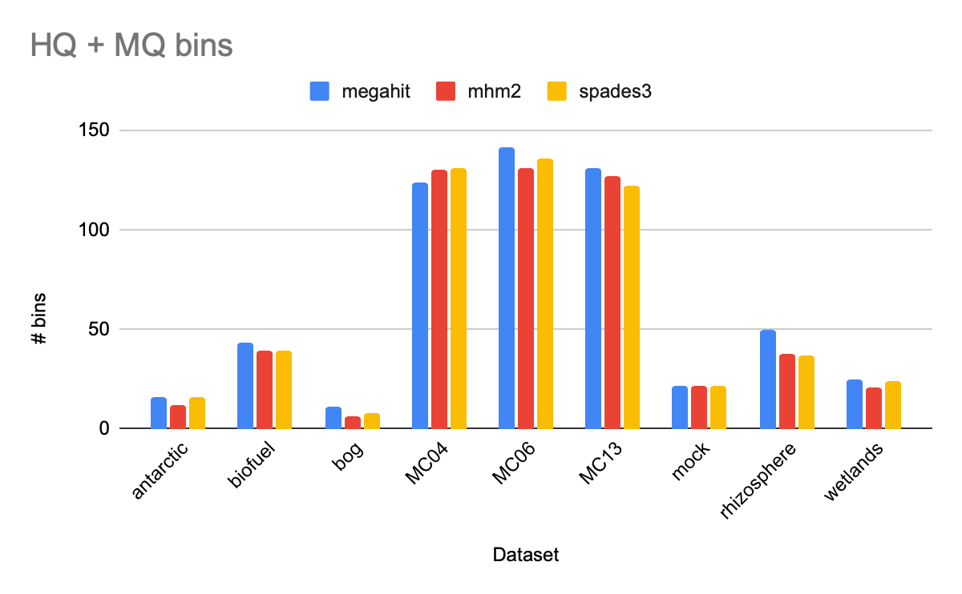
MHM2 yields comparable numbers of high quality bins to other assemblers
Samples
Reads
Contigs
CheckM
Bins
MetaBAT: Kang DD et al. 2015. MetaBAT, an efficient tool for accurately reconstructing single genomes from complex microbial communities. PeerJ 3:e1165
CheckM: Parks DH et al. CheckM: assessing the quality of microbial genomes recovered from isolates, single cells, and metagenomes. Genome Res. 2015;25(7):1043-1055
HQ and MQ bins defined by MiMAG standard: Bowers, R et al. Minimum information about a single amplified genome (MISAG) and a metagenome-assembled genome (MIMAG) of bacteria and archaea. Nat Biotechnol 35, 725–731 (2017)

Slide 20
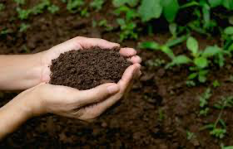
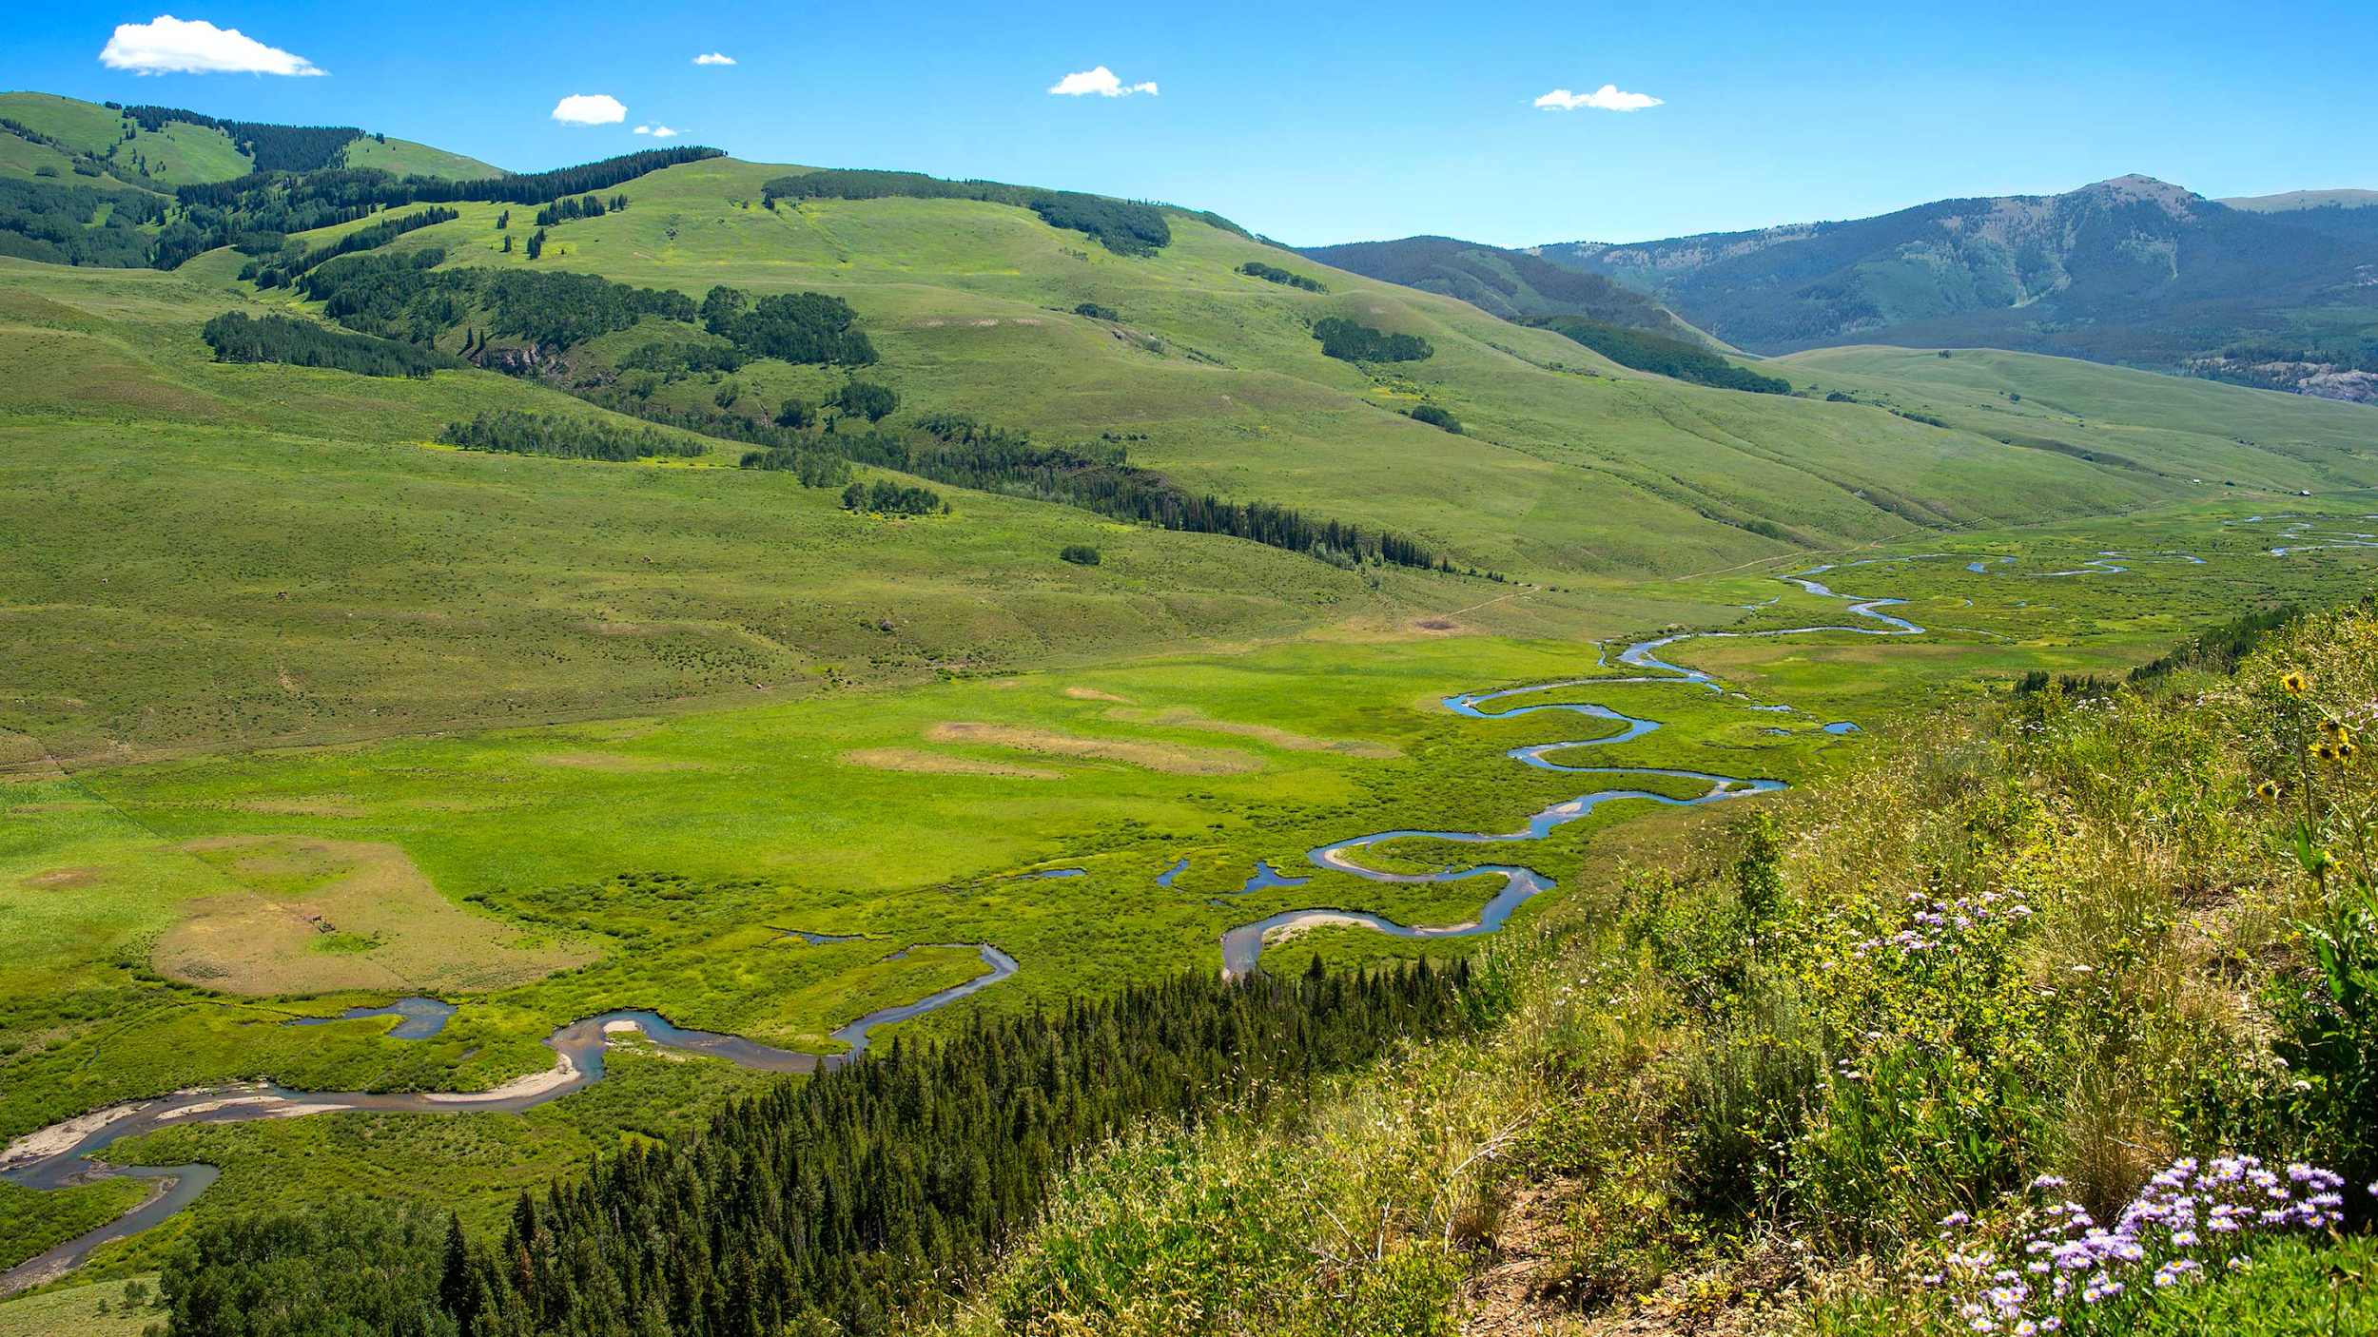
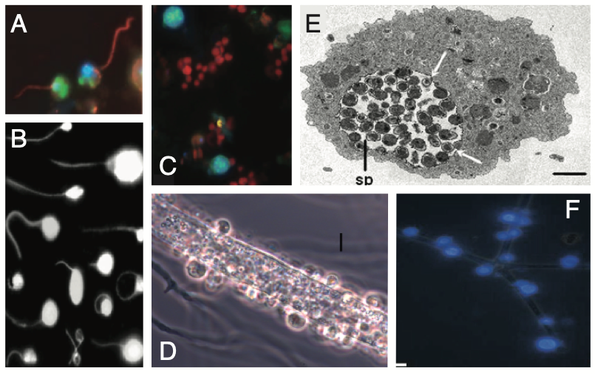
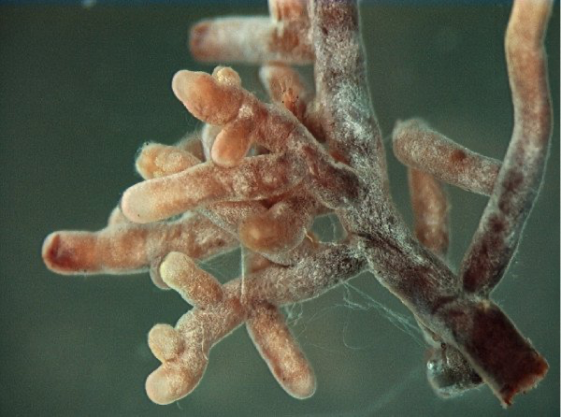
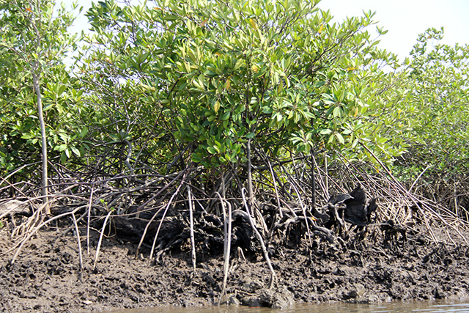
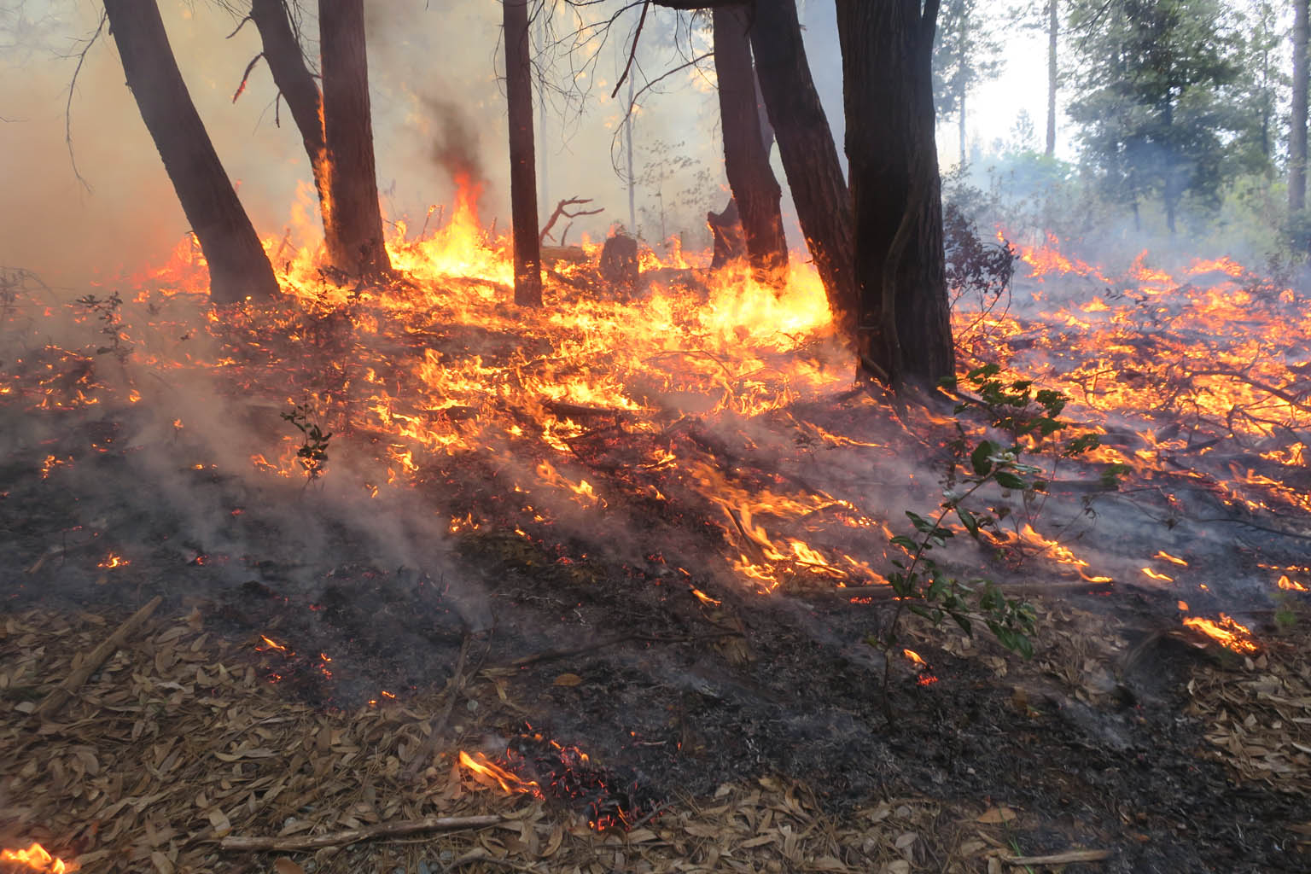
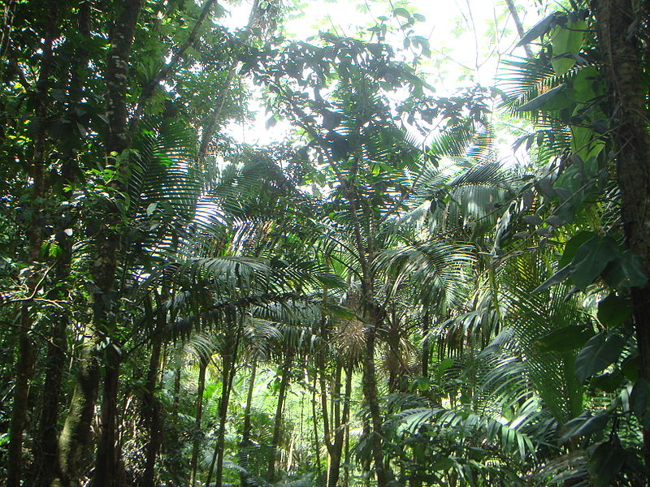
JGI user science supported by MetaHipMer
Microbial and plant phenology in a mountainous watershed (2.7 TB)
Soil carbon cycle (3.3 TB)
Dark matter fungi in Lake Erie (1.7 TB)
Ectomycorrhizal fungi (1.5 TB)
Methane production in Texas coastal mangroves (2.1 TB)
Great Redox Experiment (GRE) in wet tropical soils (8 TB)
Mixed conifer zones following prescribed fire (1.5 TB)

Slide 21
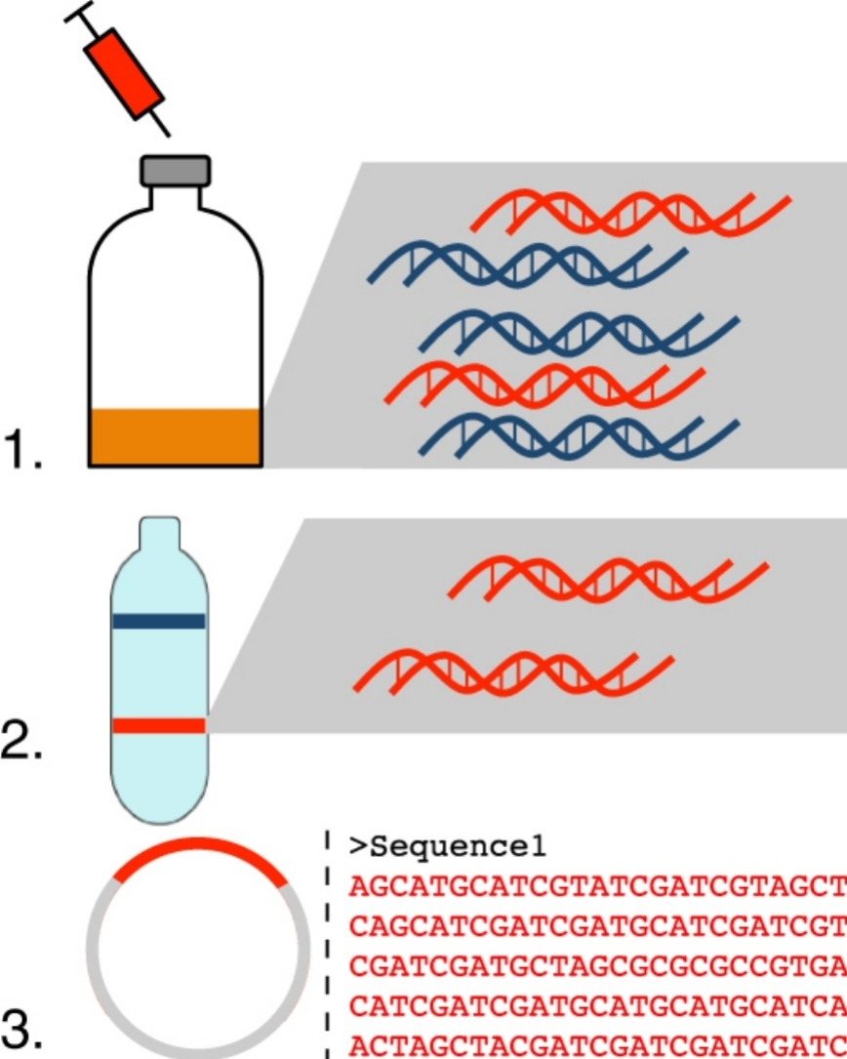
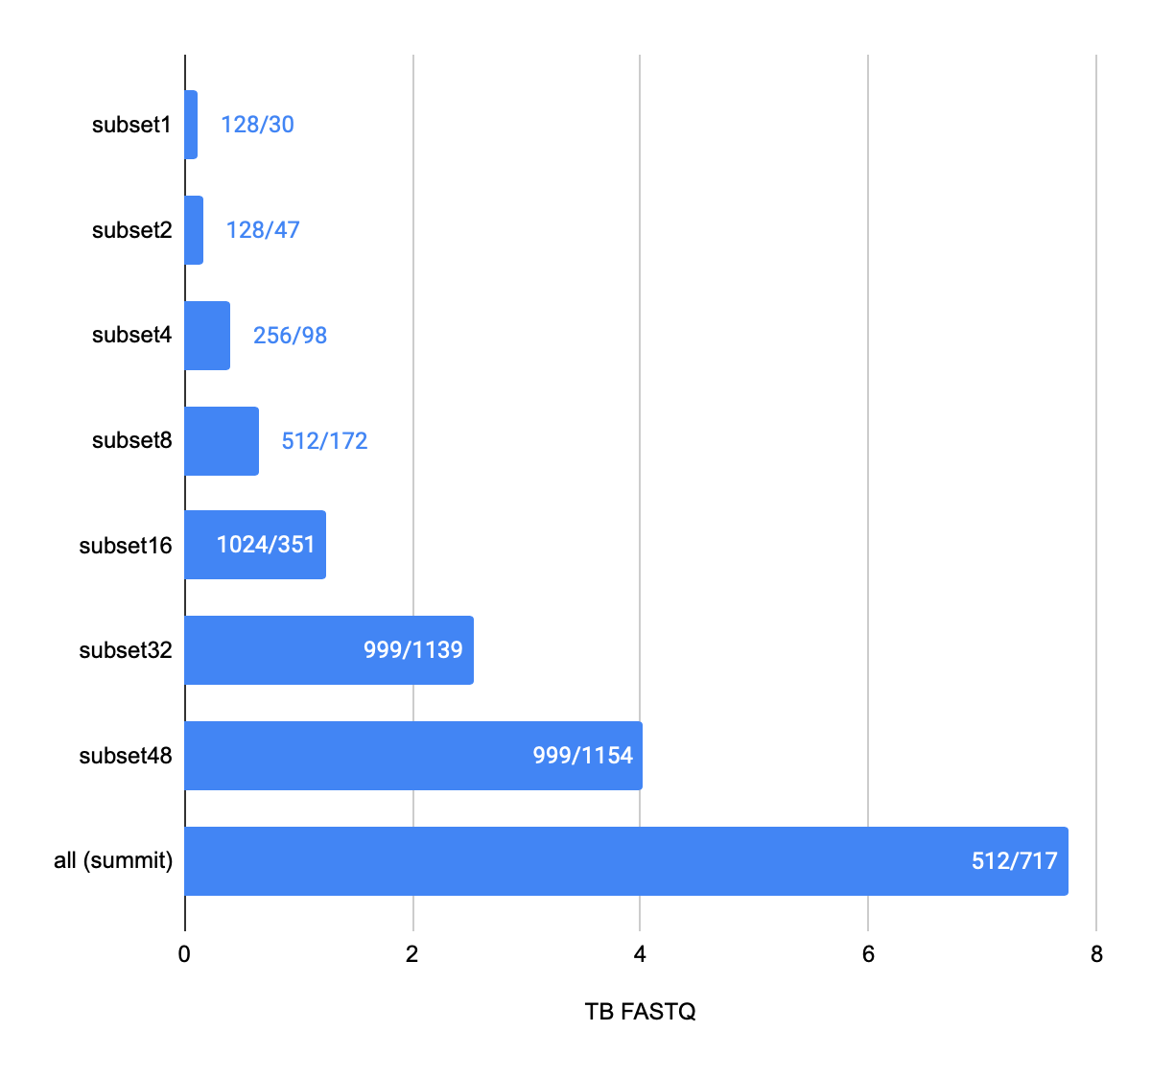
The Great Redox Experiment (GRE) 8 TB coassembly
Proposal: Microbial Carbon Transformations in Wet Tropical Soils: Effects of Redox Fluctuation
Jennifer Pett-Ridge, Jeff Kimbrel (LLNL)
Environment: Luquillo Experimental Forest (LEF), Puerto Rico soils
Scientific questions:
Address how O₂ availability and associated redox conditions affect litter decomposition and microbial community dynamics over time in LEF soils using a redox manipulation experiment with high temporal resolution and replicated soil incubations
Trace assimilation of breakdown products by specific taxa over time by adding ¹³C plant litter to half the microcosms using stable isotope probing (SIP) approaches
LEF
SIP
Largest known coassembly (8 TB) on Summit (ORNL)
nodes/node hours
MHM2
Coyotzi et al. Current Opinion in Biotechnology, v41, 2016,1-8
https://en.wikipedia.org/wiki/Luquillo_Experimental_Forest

Slide 22
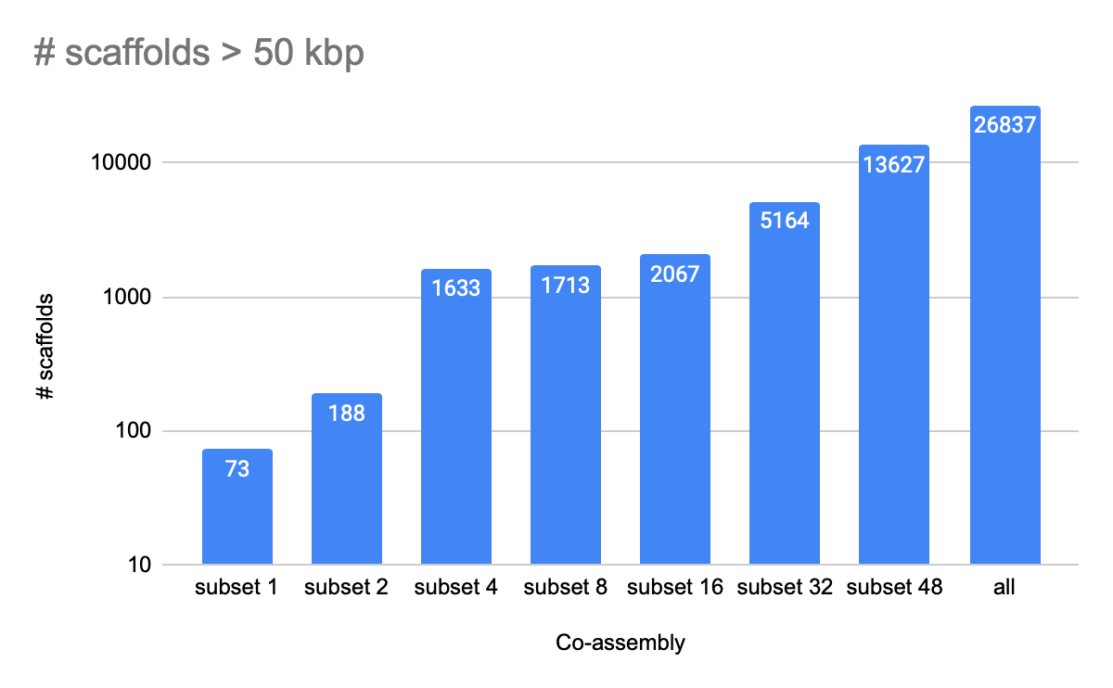
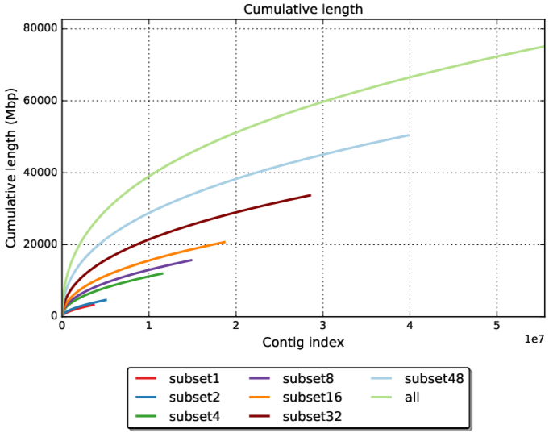
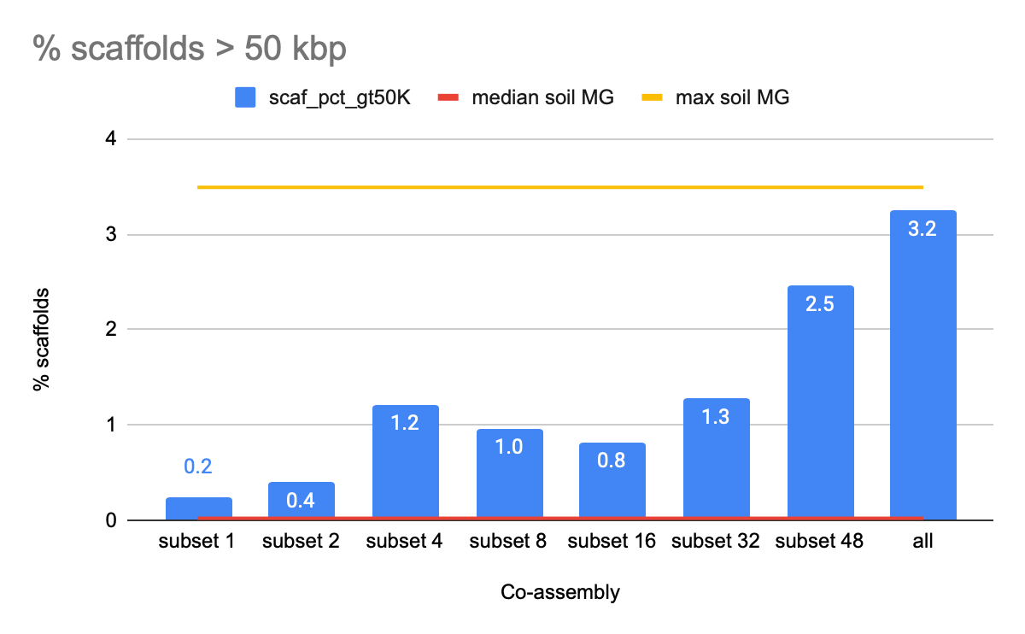
Coassembling more data yields more contiguous assemblies
3.5%
0.02%

Slide 23
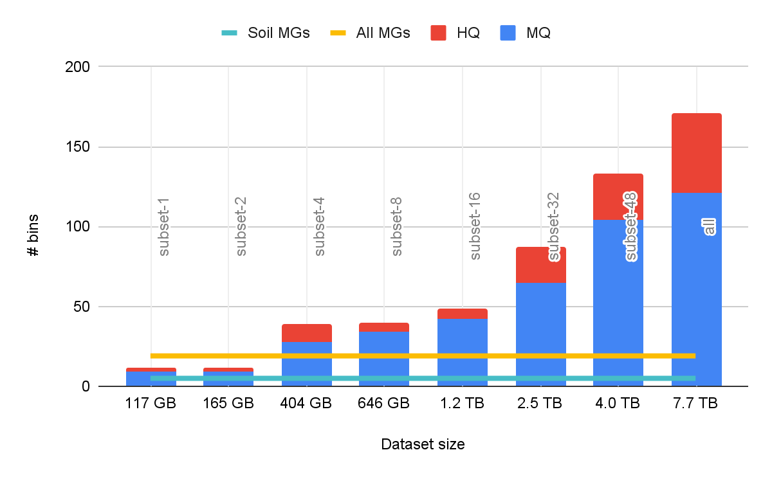
Larger coassemblies recovers more quality bins and taxonomic diversity
High (HQ) and medium (MQ) quality bins
HQ and MQ bins assigned to phyla
Bar label = dataset name
Bar label = bins assignable to phyla

Slide 24
Benefits of coassembling 8 TB of metagenome data
Simplicity: previous co-assemblies of this dataset were processed in 23 batches, complicating data management, merging and comparisons between assemblies
Time: the CPU time required for MetaHipMer to co-assemble this dataset was 50x faster than even one of our 23 co-assembly batches
Quality: the resulting contigs from the MetaHipMer co-assembly have an L50 2x the average from the 23 co-assemblies, and with 10x more data present in large contigs (>50Kb)
Unified set of contigs: advantages include increased read-depth of rare organisms, and no need for dereplication steps in metagenome assembled genome (MAG) curation

Slide 25
Is 8 TB enough sequencing?
Amount of sequencing to reach 95% coverage
Nd = 22.8
Rodriguez-R et al.. 2018. “Nonpareil 3: Fast Estimation of Metagenomic Coverage and Sequence Diversity.” mSystems 3 (3). American Society for Microbiology Journals: e00039–18.

Slide 26
Future work: towards larger ExaBiome milestones
GRE
FY23
FY23
Lake Mendota time series
FY22
GRE
FY22
FY21
FY21

Slide 27
Future work: terabases of metagenome data from around the world
Walnut Creek JGI pond SIP fractions (4.5 TB)
Lake Mendota time series metagenomes (25 TB)
Human microbiome (100 TB)
Studies | 49,577
Biosamples | 131,405
Sequencing Projects | 408,686
Analysis Projects | 320,168
Organisms | 410,763
GOLD database: https://gold.jgi.doe.gov/biosamplemap

Slide 28
Conclusions - terabase scale metagenome assembly
Metagenome coassembly detects more of the underlying genomes than multiassembly
Coassembly is important since many metagenome environments are undersequenced
MHM2 can coassemble datasets of sizes intractable to other assembly software
MHM2 achieves quality comparable to state of the art assemblers
We coassembled 8 TB of metagenome data from the Great Redox Experiment
Massive-scale metagenome coassembly can discover low-abundance microbes
Future ExaBiome milestones: 16 TB, 30 TB, and 50 TB metagenome coassemblies

Slide 29
Broader directions at the JGI
Highlights from JGI programs in
Metagenomics
Fungal genomics
Algal genomics
JGI capabilities available to users
Mechanisms to collaborate with JGI

Slide 30
Metagenome Program
People
Research areas
Publications
Function-driven Metagenomics
Phylogenomic
Novelty
IF ≤ 8
IF 8-25
IF ≥ 25
Emiley Eloe-Fadrosh
Macro-scale Microbial
Ecology
Viral-host Interactions
Simon Roux
(et al.)

Slide 31
Function-driven metagenomics
MetaHipMer for coassembly of SIP fractions
Binning using differential abundance from mapped SIP fractions for improved genome recovery

Slide 32
Long-term ecological & evolutionary processes
Lake Mendota time series metagenomes (25 TB)
Macro-scale Microbial Ecology
Coassembly of Lake Mendota metagenomes
Coassembly binning pipeline
Alicia Clum
Robert Riley
Rob Egan
Neha Varghese
Robin Rohwer

Slide 33
Long-read metagenomics of soil communities reveals phylum-specific secondary metabolite dynamics
BGC = biosynthetic gene cluster
Encode pathways for secondary metabolite production
Modular, co-localized gene architecture and large size (>10 kbp)
Communication, antagonistic interactions, nutrient scavenging
Antibiotic drug development, agriculture, biomaterials, biofuels, and cosmetics
Marc Van Goethem
Van Goethem et al.bioRxiv 2021.01.23.426502; doi: https://doi.org/10.1101/2021.01.23.426502

Slide 34
Evolution of JGI fungal genomics
2004: 1st basidiomycete genome published
2012: 1000 Fungal Genomes
Project (600+ complete)
2021: 2000+ fungal genomes in MycoCosm
https://mycocosm.jgi.doe.gov
Family-level representation
2+ genomes =343 1 genome = 183
Unsampled = 233
White rot fungus Phanerochaete chrysosporium
Grigoriev et al., NAR 2014

Slide 35
Evolution of Class II Peroxidases
LiP
MnP-l
VP
GP
MnP -ESD
MnP -DGD
MnP -DED
NPOD
Notes:
lignin peroxidases (LiP), versatile peroxidases (VP), atypical VPs (VP-a), short (MnP-s), long (MnP-l) and new (MnP-ESD, MnP-DGD, and MnP-DED) manganese peroxidases, new PODs (NPOD), and generic peroxidases (GP), the latter not involved in lignin degradation (the colored background
(A) LiP of Phanerochaete chrysosporium (PDB 1LLP) with catalytic tryptophan exposed to the solvent. (B) MnP-l of P. chrysosporium (PDB 1MnP) with Mn²⁺-oxidation site formed by Glu/Glu/Asp residues (MnP-s presents the same Mn²⁺-oxidation site). (C) VP of Pleurotus eryngii (PDB 3FJW) combining the exposed tryptophan of LiP and the Mn²⁺-oxidation site of MnP. (D) GP of Coprinopsis cinerea (PDB 1ARP) lacking both the Mn²⁺-oxidation site (a lysine residue prevents cation binding) and the exposed tryptophan. (E–G) Homology models of the MnP-ESD (from Cyathus striatus, JGI ID 1429066), MnP-DGD (from Agrocybe pediades, JGI ID 699589), and MnP-DED (from Peniophora sp., JGI ID 91330) enzymes, characterized by alternative Mn²⁺-oxidation sites (formed by Glu/Ser/Asp, Asp/Gly/Asp, and Asp/Glu/Asp residues, respectively). (H) Homology model of the NPOD enzyme (from C. striatus JGI ID 1391496)

Slide 36
Scaling up Algal Genomics at JGI
Early 2000s:
1st JGI Algal Genomes
2018: JGI Strategic Focus
on Algal Genomics
2020: 100+ algal genomes in PhycoCosm
https://phycocosm.jgi.doe.gov
Grigoriev et al., NAR 2021

Slide 37
Algal Multi-omics for Strain Improvement
Sara Calhoun
Halotolerant Scenedesmus sp. NREL 46B-D3 at 25°C produces 30 g/m²/day (top biomass accumulation)
Multi-omics: expanded and expressed genes involved in lipid production, ion channels and anti-porters
Under cold stress many fatty acid biosynthesis genes are overexpressed with specific transcription factors, targets for strain improvement.

Slide 38
JGI capabilities for user science
The JGI provides users around the world with access to high-throughput capabilities including DNA and RNA sequencing, synthesis, metabolomics, and data analysis through Community Science Program
DNA Sequencing
Illumina platforms: NovaSeq, HiSeq, MiSeq, Next Seq
PacBio platforms:
Sequel I and II
Oxford Nanopore
platforms:
MinION, PromethION
Advanced Genomic Technologies
Single-cell Seq
Metabolomics
Epigenomics
Transcriptomics
DAP-seq, Drop-seq
DNA Synthesis
Construct Design
Pathway Assembly
Host Engineering
Gene/Genome Libraries
DAP-Seq
T
PacBio Sequel II
T
^{Me} C T C G
^{T} A
^{C} T
T ^{A}
T A
Me
C
T U
G
^{G} C
Bisulfite sequencing ATAC-Seq
Data Science and Informatics
Scalable Data Processing, Analysis and Access
Data Platforms
High-Performance Computing
Metabolic Modeling
Microbiome Data Science
Illumina NovaSeq

Slide 39
Mechanisms for collaboration with JGI
No charge to Users
Peer-reviewed for scientific merit and DOE relevance
Users can own IP with public release of data
Fee-for-service
Partners can own IP
DOE relevant
Community Science Program (CSP)
Sponsored Research
Annual CSP Large-Scale Call
Genome sequencing and resequencing for bacteria, archaea, fungi, algae, plants
RNA sequencing for genome annotation and for transcriptional profiling
Epigenomics, metagenomics and metatranscriptomics
DNA synthesis for functional assays
Metabolomics based functional analyses
Facilities Integrating Collaborations for User Science (FICUS) Call
Access JGI resources and proteomics, metabolomics,
and imaging capabilities from the Environmental Molecular Science Laboratory (EMSL) in one proposal.
New Investigator Call (1-2x per year)
Functional Genomics Call (2x per year)
Synthesis of genes, pathways, sgRNA libraries
Metabolomics based functional analyses
RNA-seq for transcriptional profiling

Slide 40
Calls for user proposals

Slide 41
Future of FICUS program includes structural biology emphasis

Slide 42
More info in JGI Strategic Plan
https://jgi.doe.gov/wp-content/uploads/2019/01/2019_JGI-Strategic-Plan.pdf

Slide 43
Acknowledgements
Rob Egan
Steve Hofmeyr
Alicia Clum
Alex Copeland
Evangelos Georganas
Eugene Goltsman
Aydin Buluc
Marquita Ellis
Andrew Tritt
Bill Arndt
Daniel Rokhsar
Leonid Oliker
Katherine Yelick
Emiley Eloe‐Fadrosh
Simon Roux
Neha Varghese
Robin Rohwer
Dariia Vyshenska
Marcel Huntemann
Bob Bowers
Marc Van Goethem
Andrew Osborn
Brian Bushnell
Amy Chen
Brian Foster
Kelly Cobaugh
Jennifer Pett-Ridge
Jeff Kimbrel
Questions? rwriley@lbl.gov

